Slide 1
Linked list
Write a program to generate and store all prime numbers between 1 and 1,000000.
Using Array:
the size of the array needs to be declared.
the number of the prime numbers is not known.
to store all the prime numbers, you have to declare an array of an arbitrarily large size.
in the worst case, an array of size 1,000000.
depending on the size declared, all the prime numbers may not be stored or memory space will be wasted.

Slide 2
Cont…
Hence you cannot use array
What can you do in such situation?
Use a dynamic structure that does not require you to specify the size in advance and allows memory to be allocated as and when it is needed.
Example of such structure is a linked list
Linked list allocates memory dynamically
Useful in operations where frequent manipulation of data is required ( insertion and deletion)

Slide 3
Dynamic memory allocation
Write a program to store the first 10 prime numbers.
here the number of prime numbers to be stored is known in advance
therefore, you can declare an array and specify its size
e.g:
prime[10]
in this case, when the code is compiled, memory space is allocated to store 10 integers
This is called static memory allocation

Slide 4
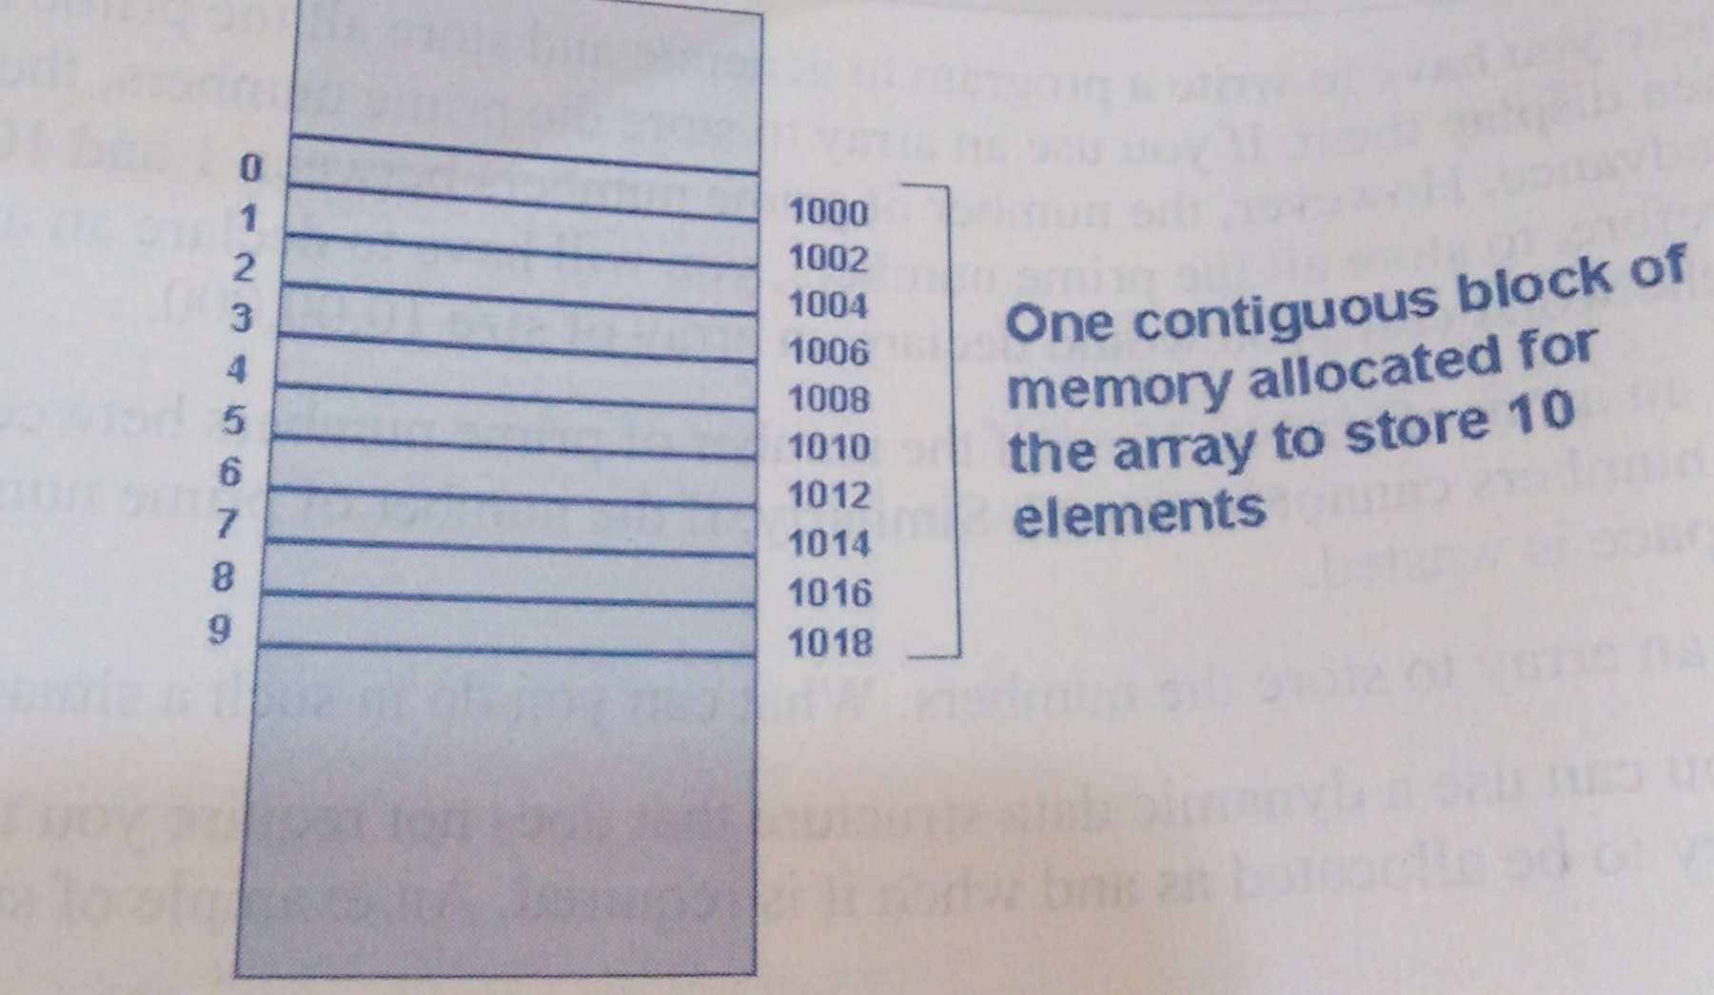
Static memory allocation

Slide 5
Cont…
You can see that one contiguous block of memory is allocated for the array, hence, if you know the address of the first element of the array, you can easily calculate the address of the rest of the elements

Slide 6
Cont…
Now consider the scenario of storing prime numbers between 1 and 1,000000. because the number of the prime numbers is not known in advance, we need a data structure that allows the allocation of memory at runtime.
When memory is allocated in this manner, the various chunks of memory will not be contiguous. They would be rather spread in the memory.

Slide 7
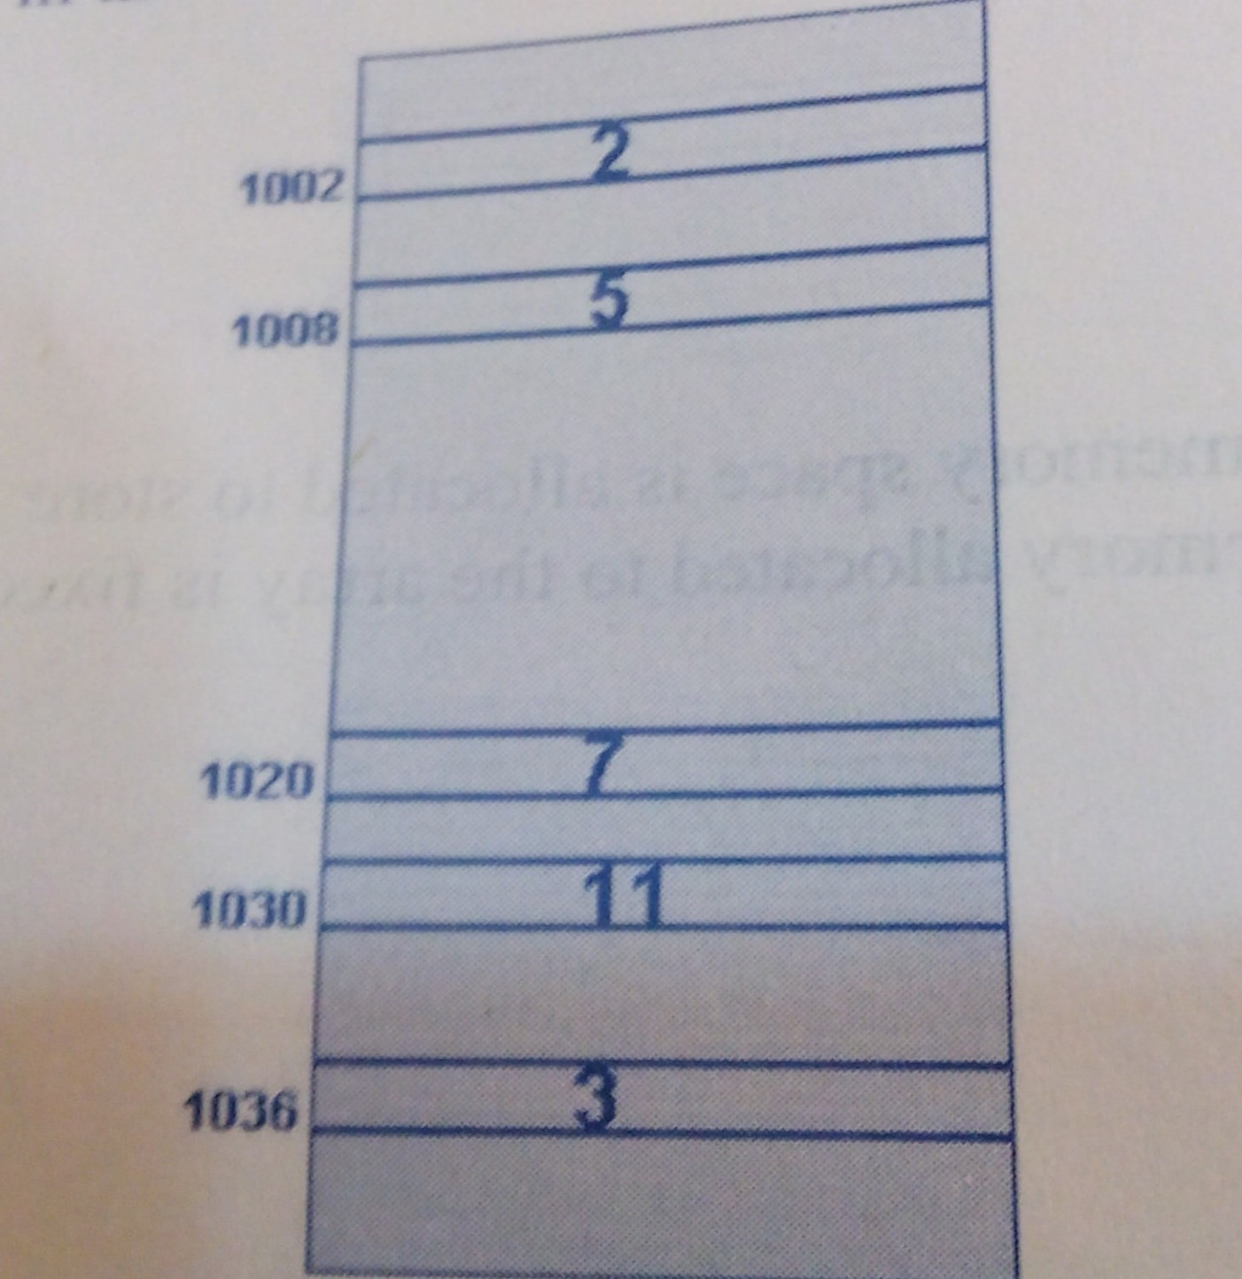
Dynamic memory allocation

Slide 8
Cont…
In this case, if you know the address of the first element, you cannot calculate the address of the rest of the elements.
This is because all elements are stored at random locations in the memory.
To solve this problem, each allocated memory block can be made to hold the address of the next block in the sequence
This gives the blocks of memory a linked structure, where each block is linked to the next block in sequence

Slide 9
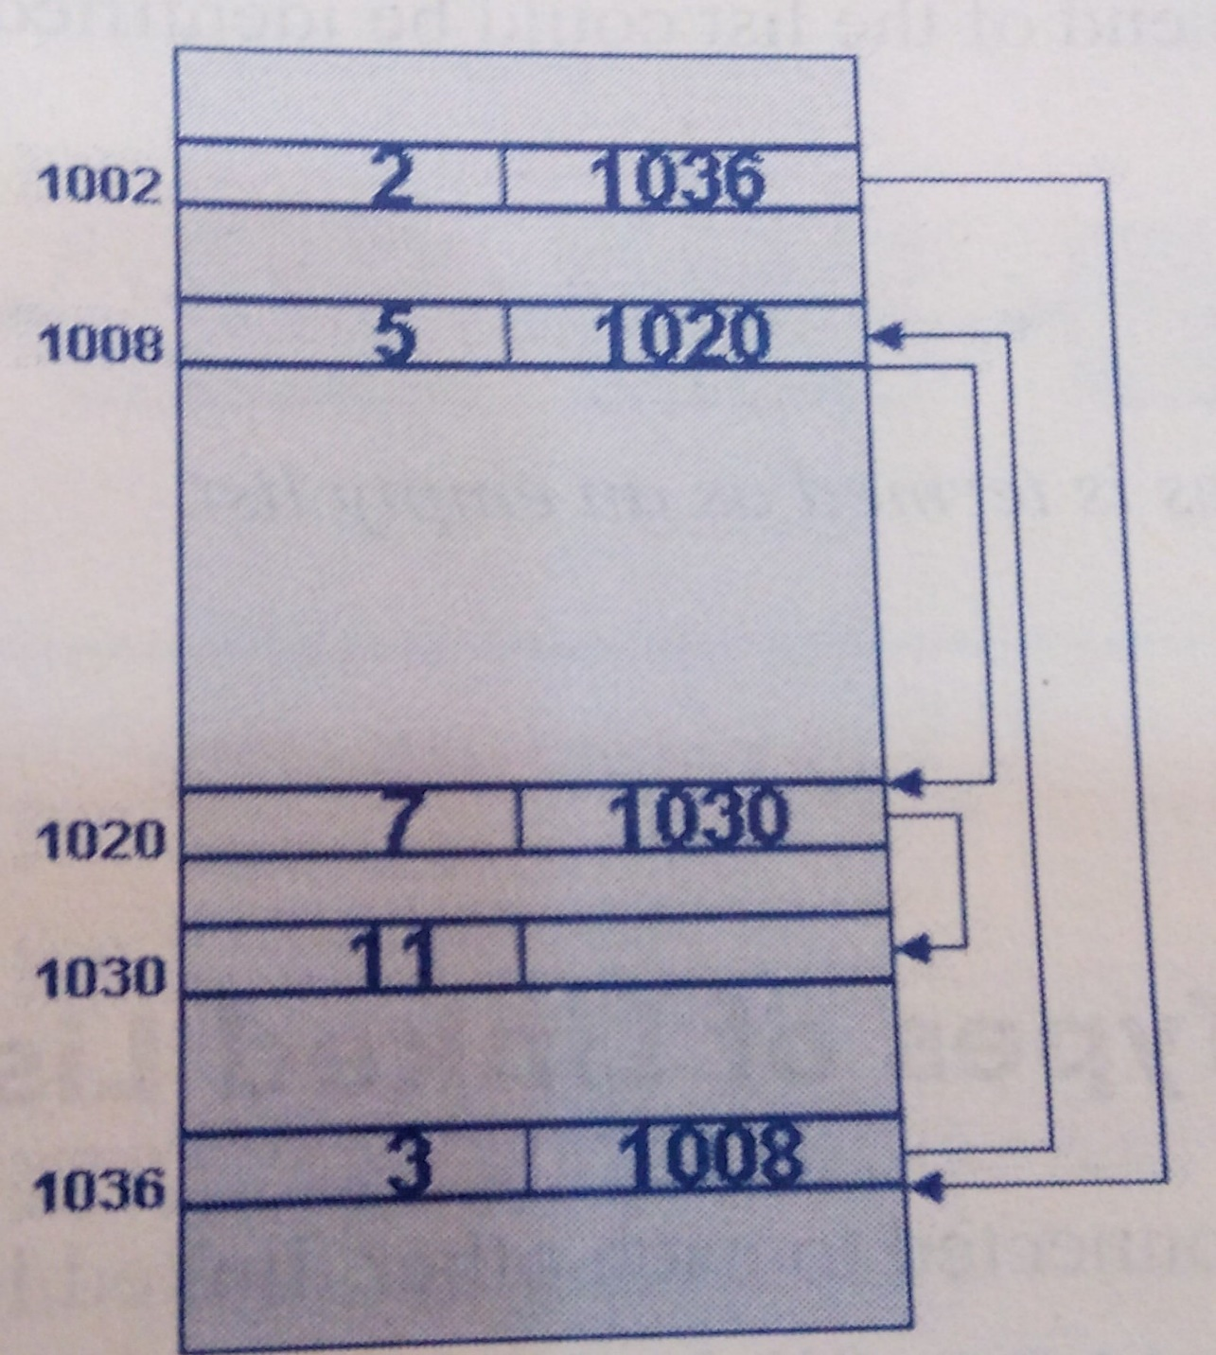
Linked representation of dynamically allocated memory

Slide 10
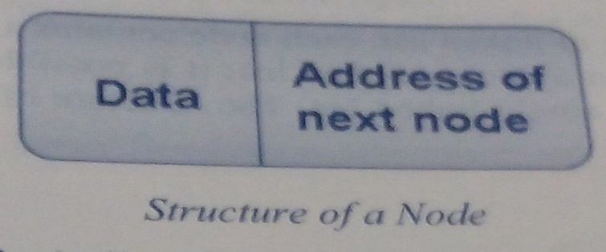
Definition of linked list
A linked list is a chain of elements in which each element consists of data as well as a link to the next element.
The link stores the address of the next logically similar element in the list
Each such element of a linked list is called a node.

Slide 11
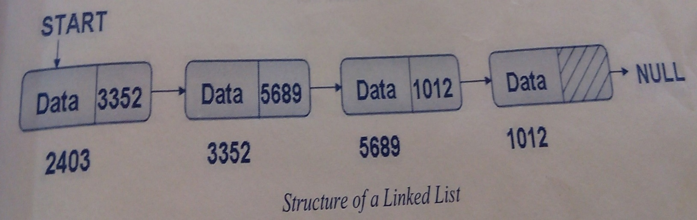
Cont…
Through the address field, one node logically references another node of the same type in the linked list.

Slide 12
Cont…
Each node in a linked list contains the address of the next node in the list.
However, there is no node that contains the address of the first node.
To keep track of the first node of the list, a variable START is used
START contains the address of the first node in the list
When the list does not contain any nodes, START is set to the value NULL
The last node does not contain the address of any other node. Therefore, the content of the NEXT field of the last node is set to NULL so that the end of the list could be identified.

Slide 13
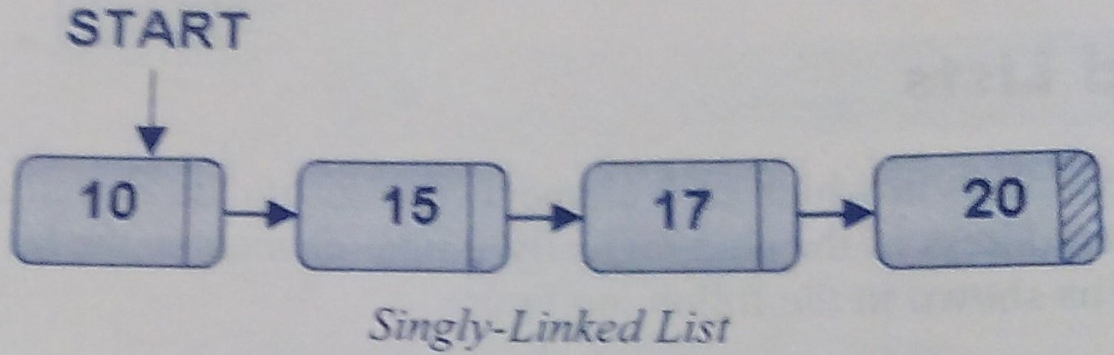
Types of linked list
Based on how the various nodes are connected to each other, linked lists can be of different types:-
Singly-linked list: it is the simplest type of linked list, where each node point to the next node.

Slide 14
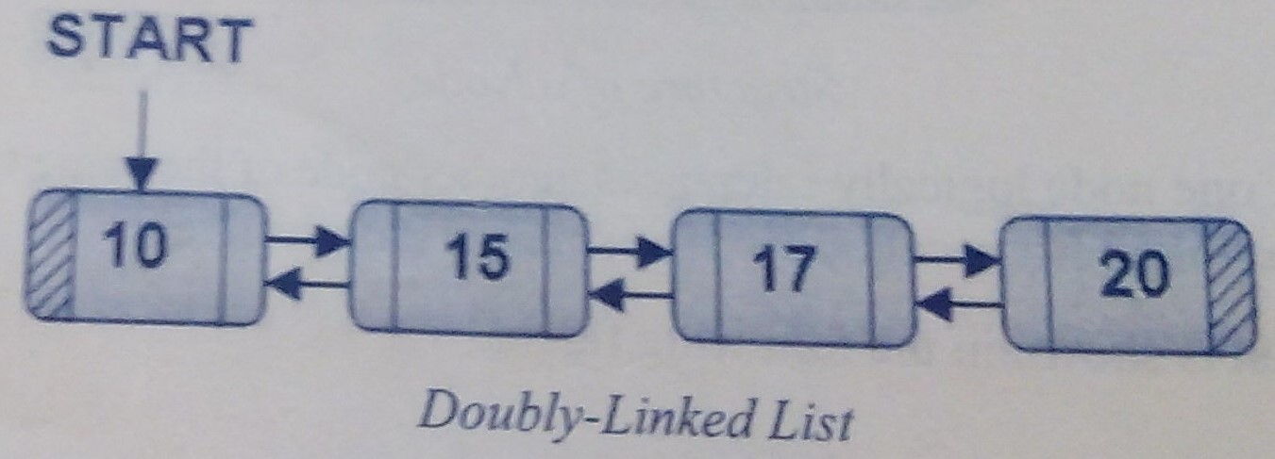
Cont…
Doubly-linked list: In this type of linked list, each node contains reference to the next node as well as the previous node

Slide 15
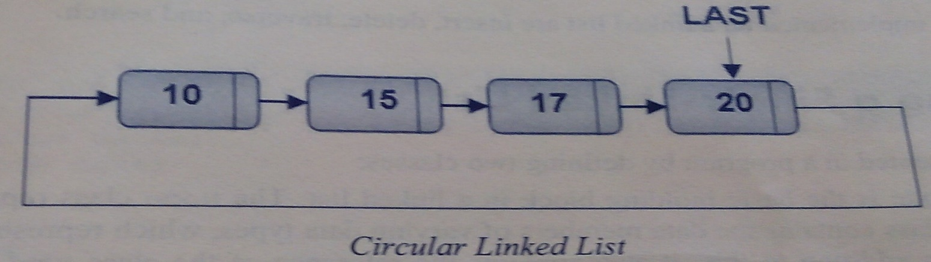
Cont…
Circular linked list: It is similar to a singly-linked list where each node points to the next node in the list. The difference lies in the arrangement with the last node where the last node points to the first node instead of pointing to NULL.

Slide 16
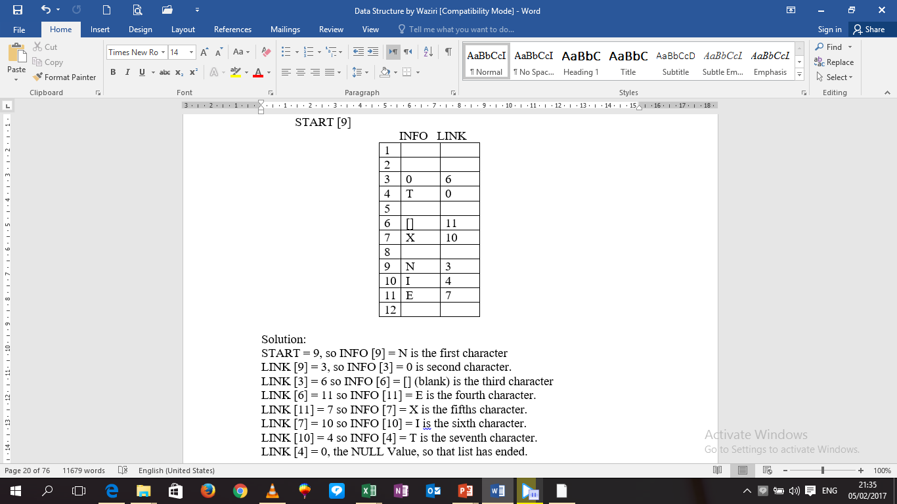
Example: 1
START [9]

Slide 17
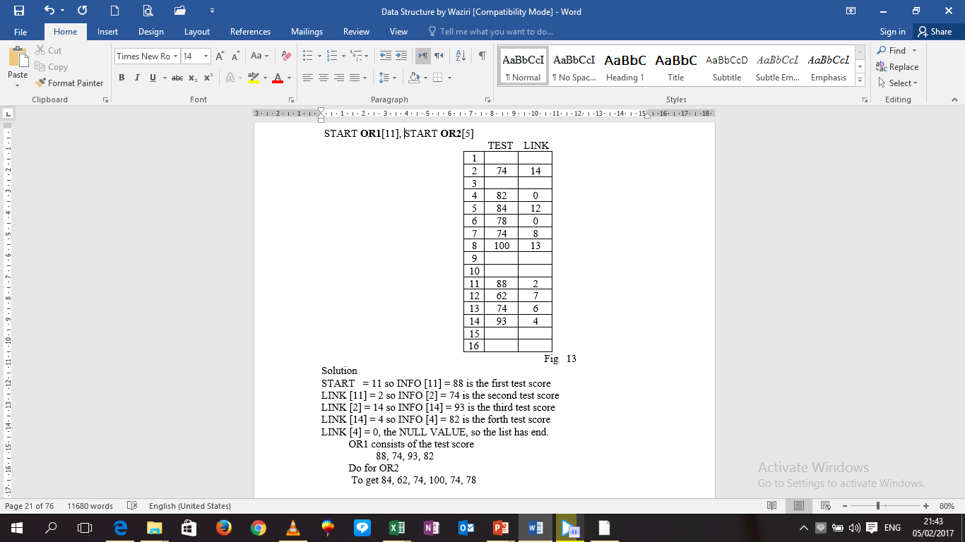
Example: 2
The below picture show two test scores, here OR1 and OR2 maintained in memory where the nodes of both list are stored in the same linear array TEST and LINK. Here OR1 contains 11, the location of the first node, and OR2, contains 5, the location of its first node.

Slide 18
Example: 3
Consider the below data
S/N | REGISTRATION No. | SUPERVISORS
1. | Sci/04/com/ 04701 | Dr. A.A MUSA
2 | Sci/04/com/04702 | Prof. I. AUWAL
3 | Sci/04/com/04703 | Dr. J.K AUDU
4 | Sci/04/com/04704 | Prof. I. AUWAL
5 | Sci/04/com/04705 | Dr. J.K AUDU
6 | Sci/04/com/04706 | Prof. I. AUWAL
7 | Sci/04/com/04707 | Dr. A.A Musa
8 | Sci/04/com/04708 | Dr. J.K AUDU
9 | Sci/04/com/04709 | Prof. I. AUWAL
10 | Sci/04/com/04710 | Dr. A.A MUSA
11 | Sci/04/com/04711 | Prof. I. AUWAL
12 | Sci/04/com/04712 | Dr. A.A MUSA
To form the below table, choose arbitrarily student that is supervised by Dr. A.A Musa (for e.g) and put the point to the student. That student will contain a link that is pointing to the next student e.t.c. the last student for the supervisor will have zero as his link (Since he is in the list).

Slide 19
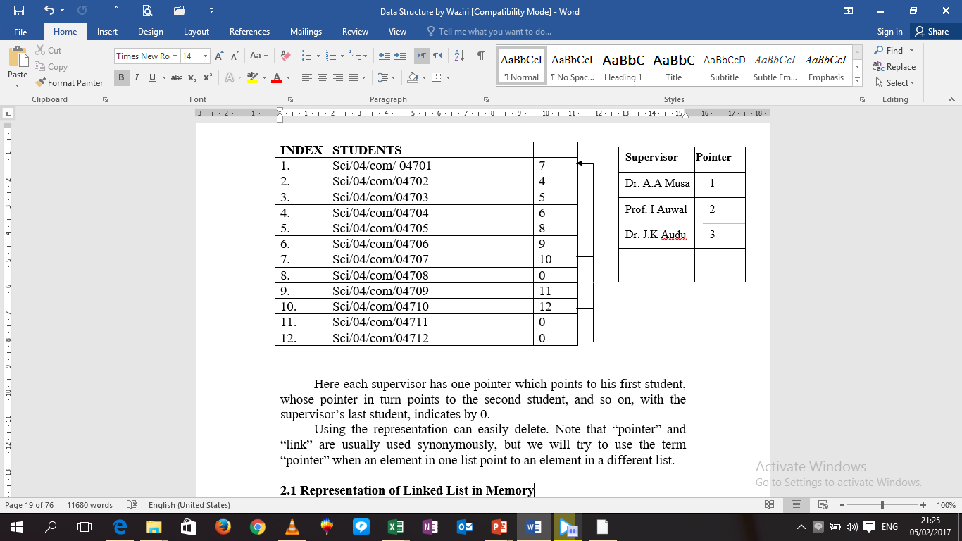

Slide 20
Traversing a singly-linked list
Traversing a linked list refers to the process of visiting each node of the list starting from the beginning
Algorithm
Make currentNode point to the first node in the list
Repeat step 3 and 4 until currentNode becomes NULL
Display the information contained in the node marked as currentNode
Make currentNode point to the next node in the sequence

Slide 21
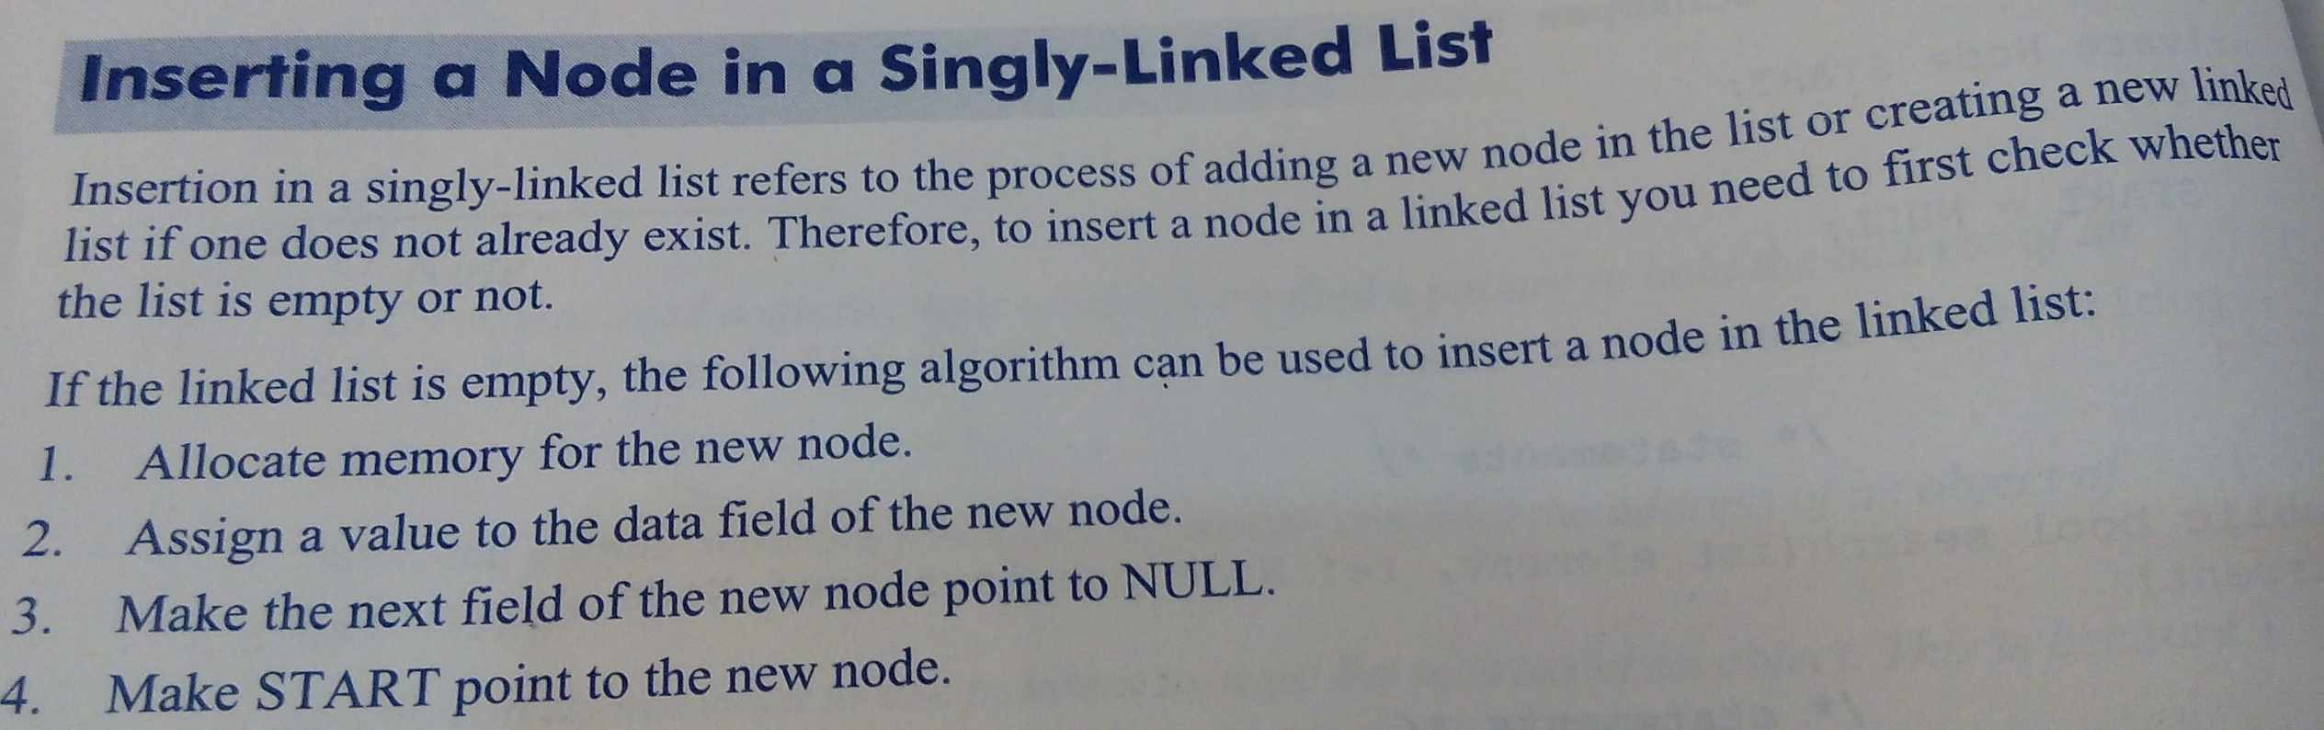
Inserting a node in singly-linked list

Slide 22
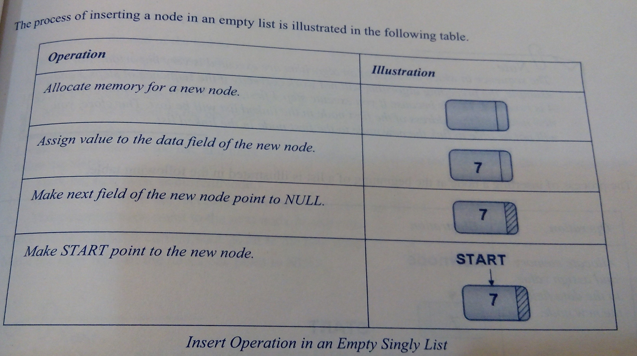

Slide 23
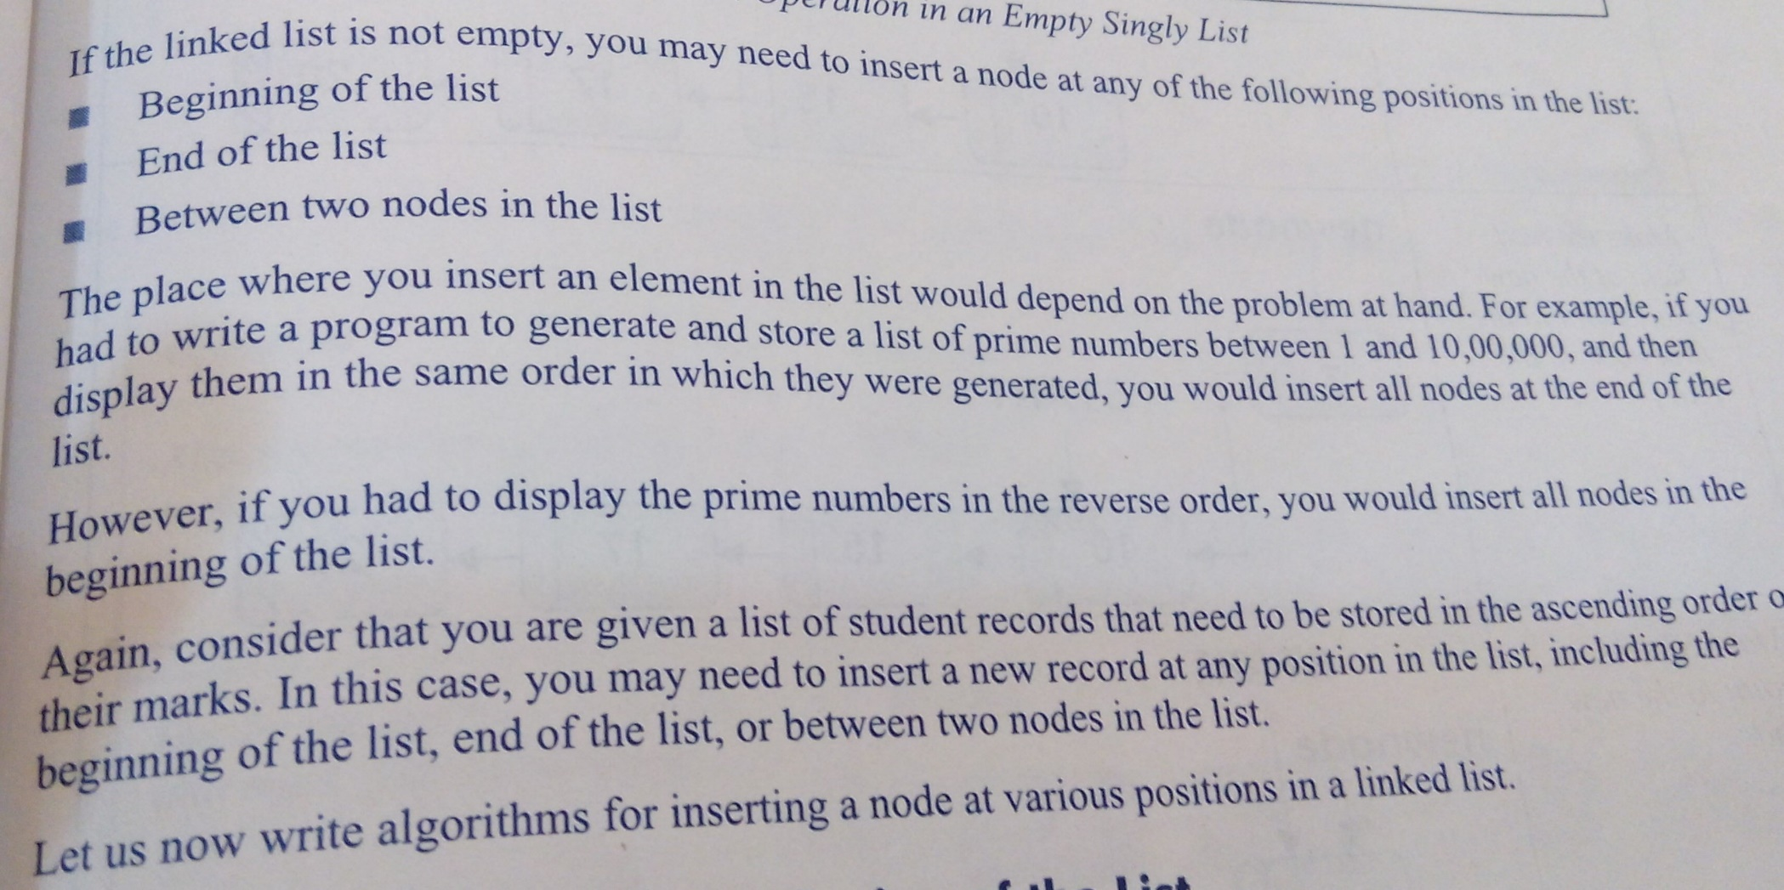

Slide 24
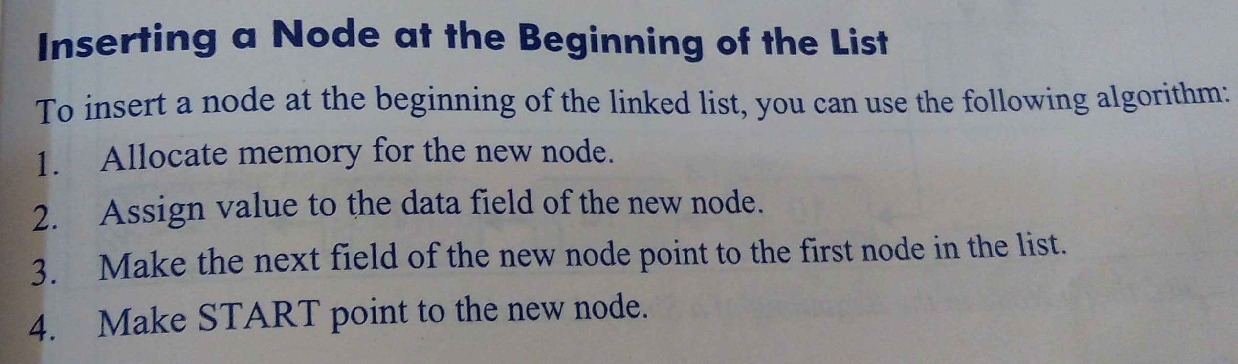

Slide 25
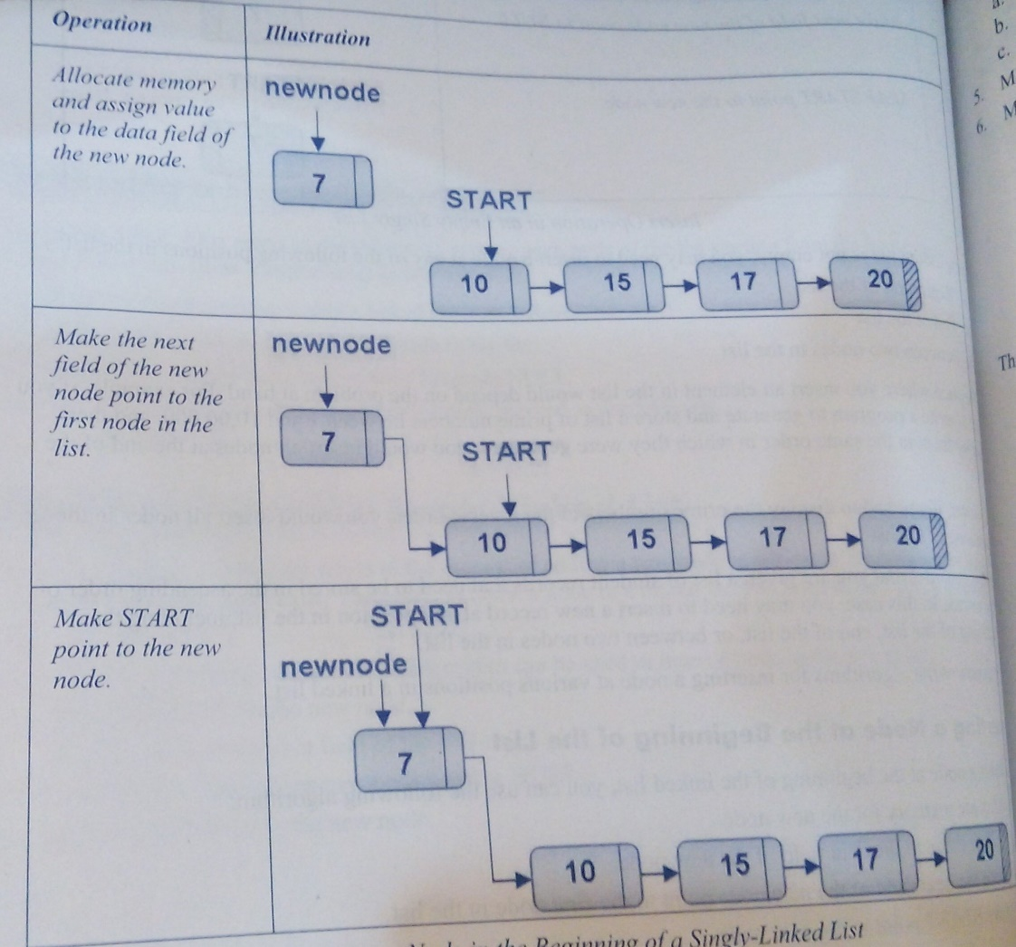
Inserting a node in the beginning of a singly linked list

Slide 26
Inserting a node at the end of the list
Allocate memory for the new node
Assign value to the data field of the new node
Locate the last node in the list, and mark it as currentNode
Make the next field of the currentNode point to the new node
Make the next field of the new node point to NULL

Slide 27
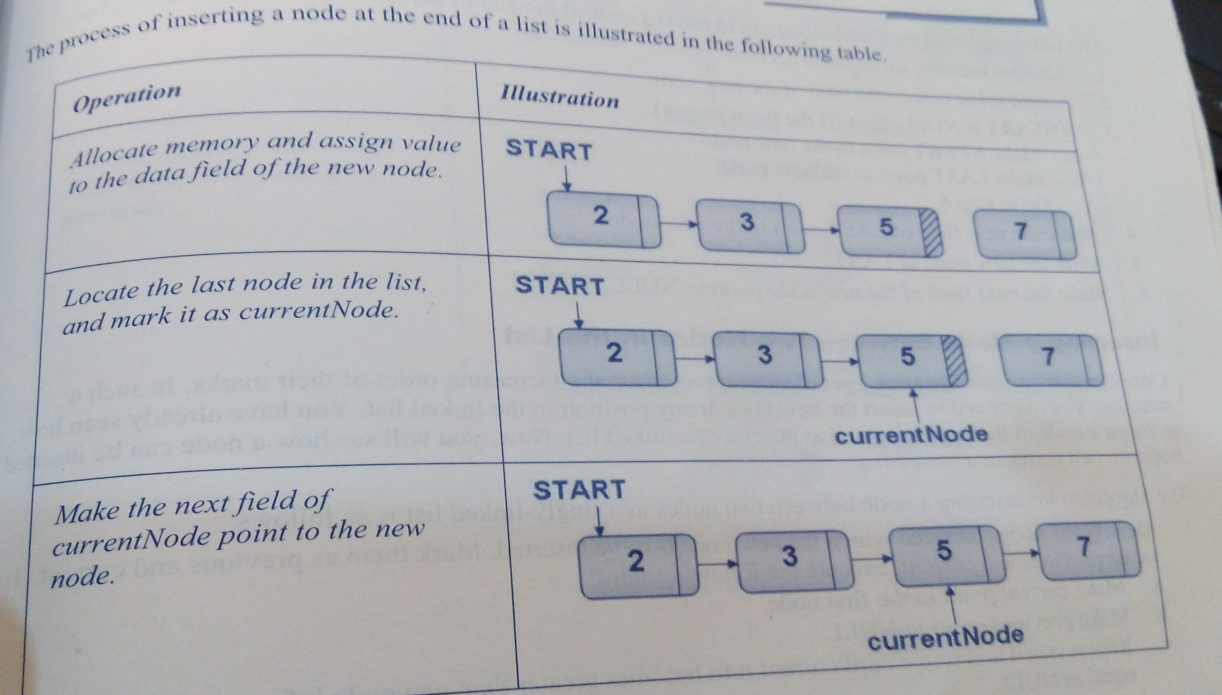

Slide 28
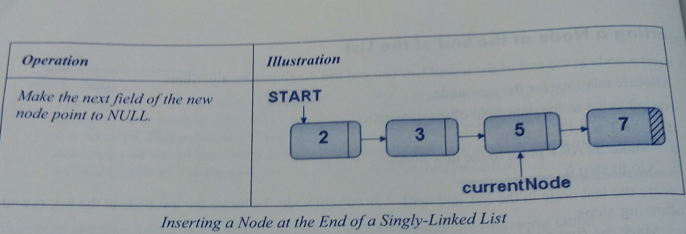
Cont…

Slide 29
Inserting a node between two nodes in the list
Identify the nodes between which the new node is to be inserted. Mark them as previous and current.
Allocate memory for the new node
Assign value to the data field of the new node
Make the next field of the new node point to current
Make the next field of the previous point to the new node

Slide 30
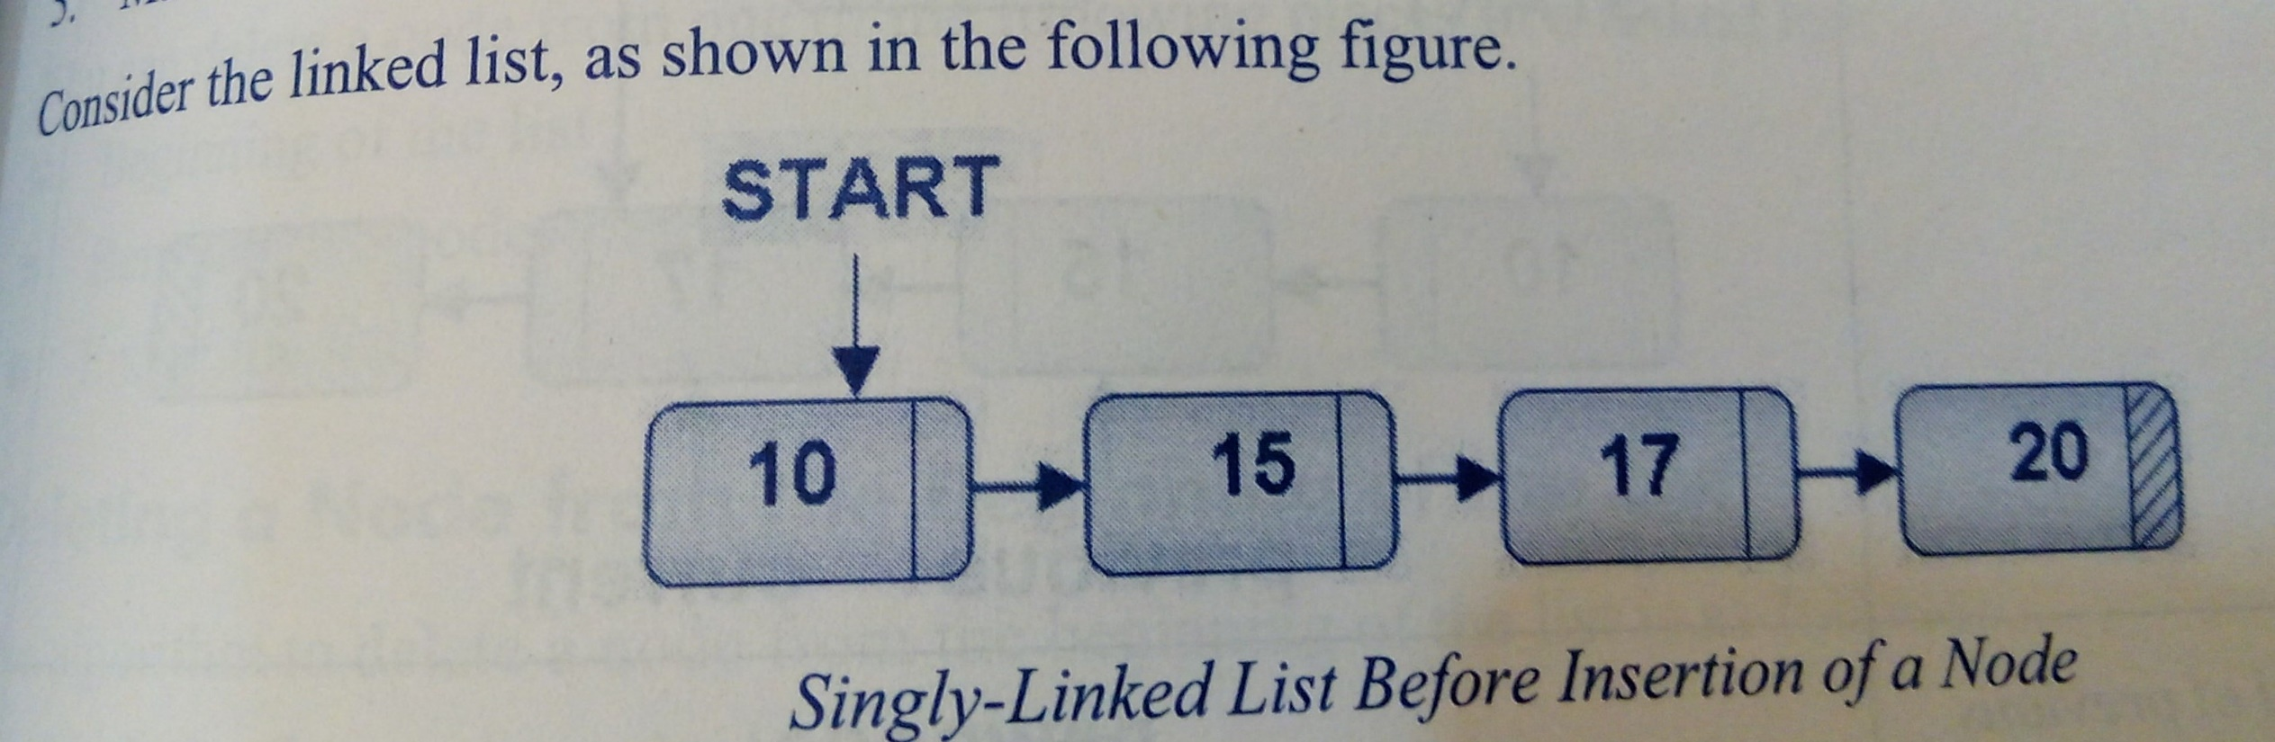

Slide 31
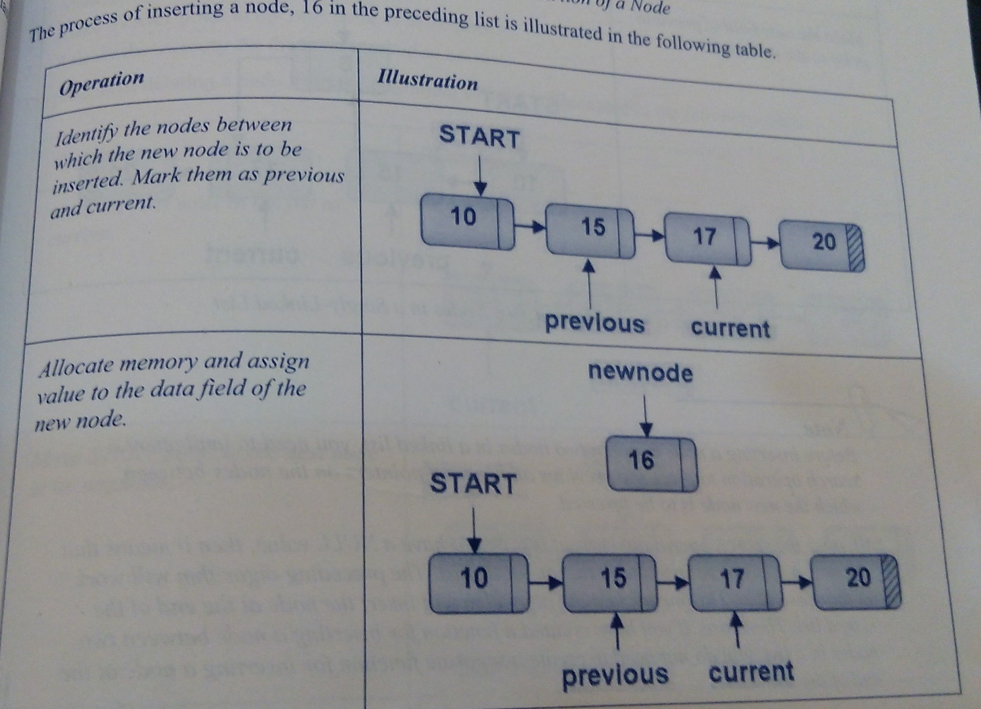

Slide 32
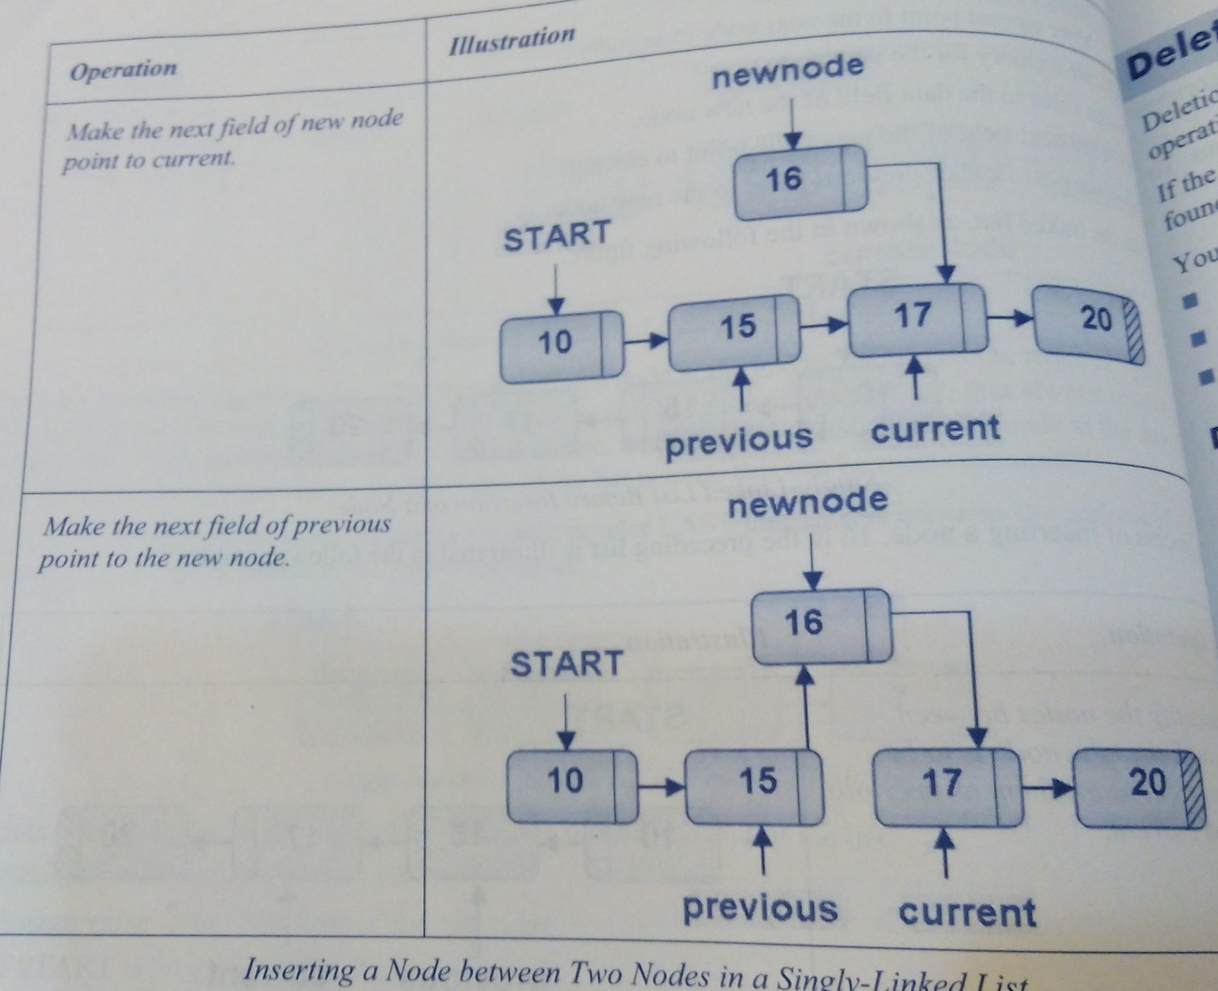
Cont…

Slide 33
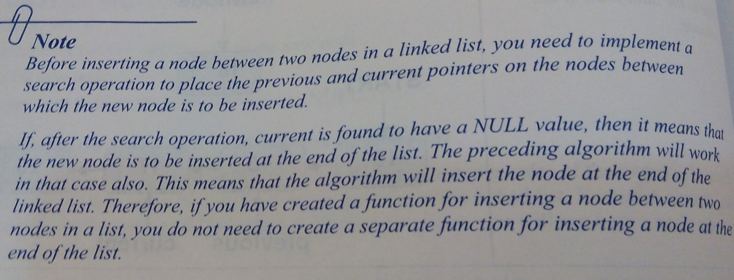

Slide 34
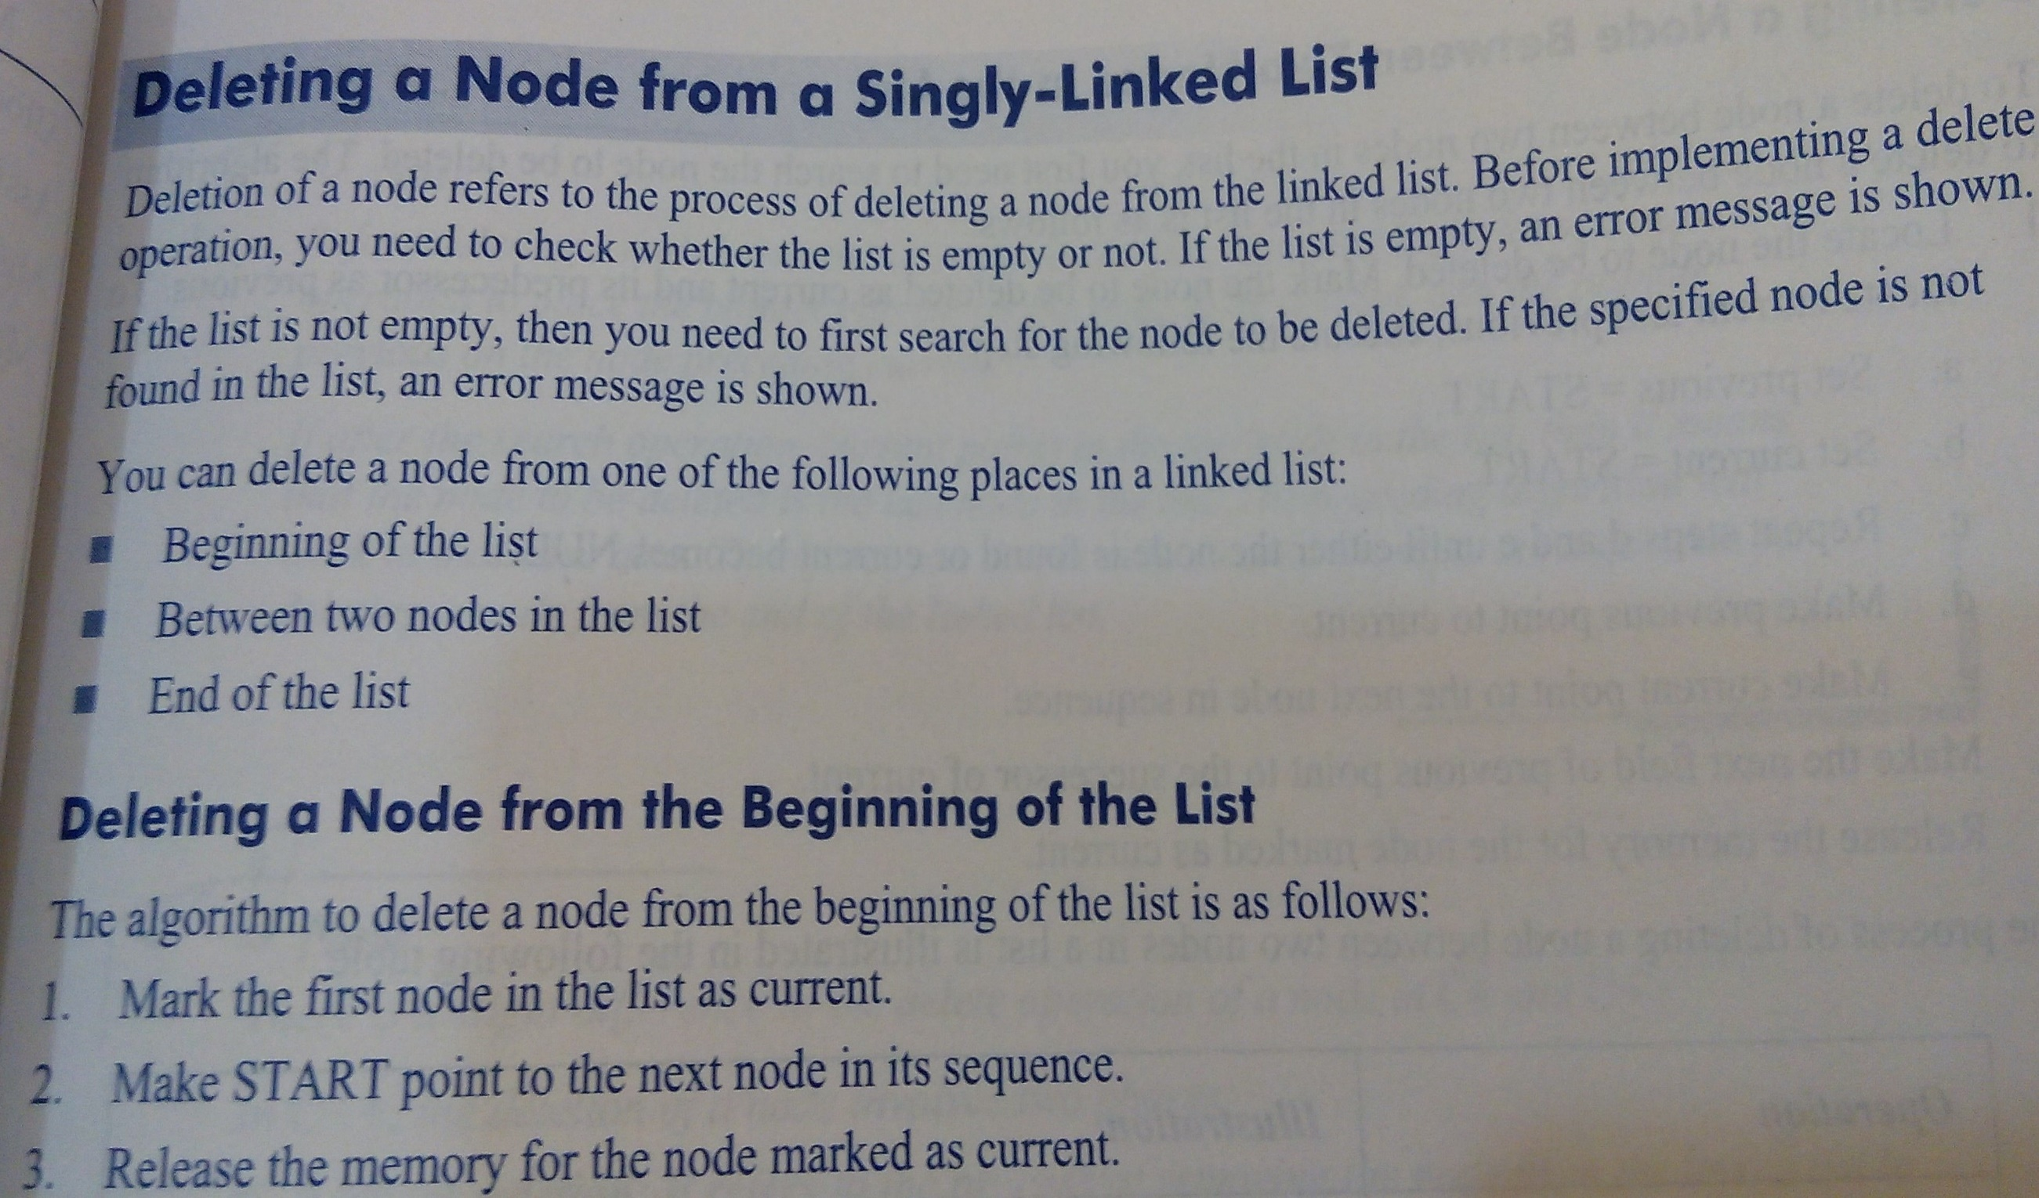

Slide 35
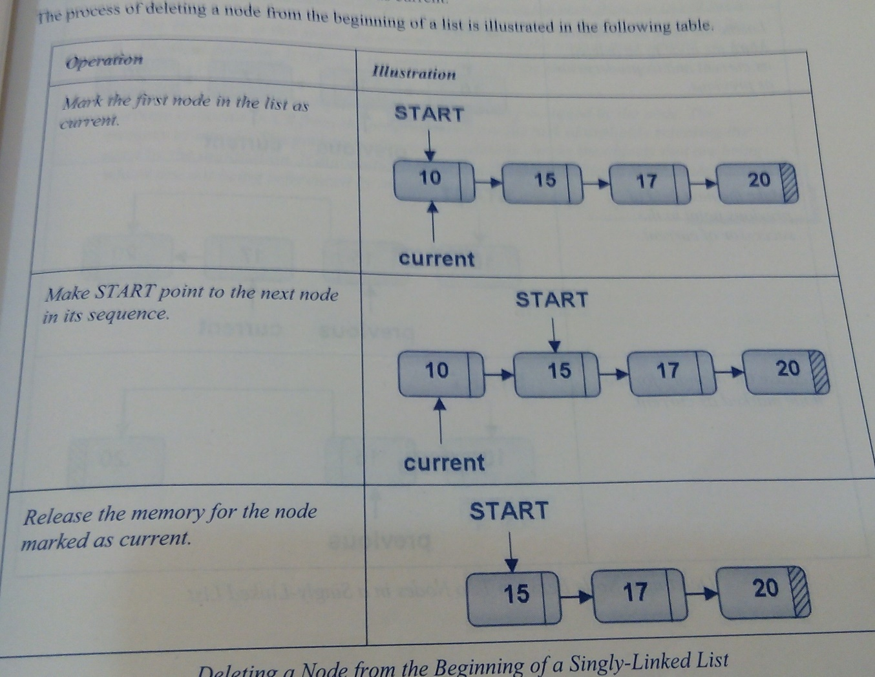

Slide 36
Deleting a node between two nodes in the list
Locate the node to be deleted. Make the node to be deleted as current and its predecessor as previous
Make the next field of the previous point to the successor of current
Release the memory for the node marked as current

Slide 37
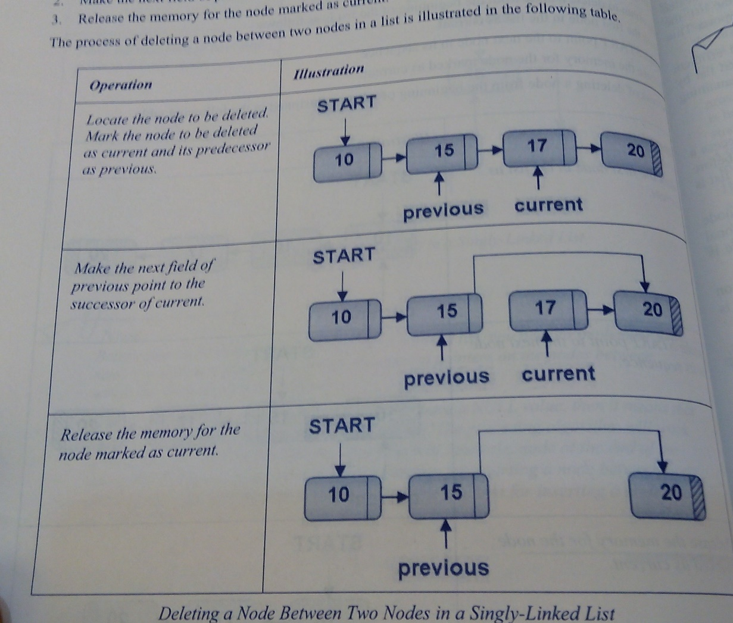

Slide 38


Slide 39
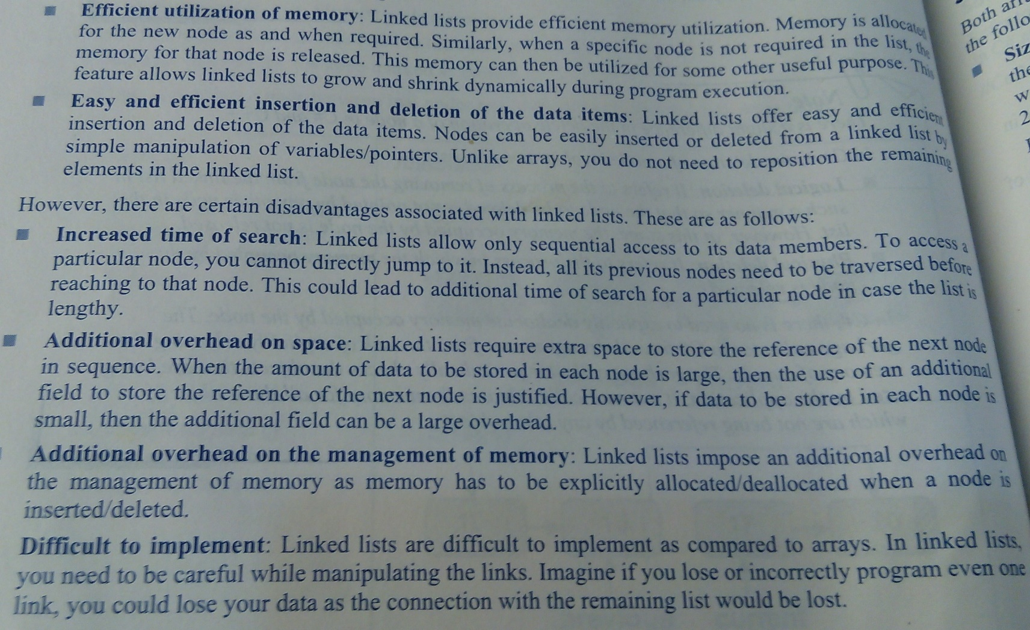
Advantages and Disadvantages

Slide 40
Application of Linked lists
Gaming Applications
Game in which the player protects himself from the enemy by firing bullets.
Whenever the bullet is fired, its details need to be stored somewhere.
The details of the bullets are stored in a linked list.
Whenever the player fires a bullet, a node is added to the linked list.
When the bullet hits a target, the node corresponding to that bullet is removed from the linked list.

Slide 41
Cont…
File system in Operating System
A file is divided into blocks, which are scattered randomly on the disk.
When a new file is created, a new block of memory is allocated to it.
When the file completely uses the memory available in that block, and requires more memory space, a new block is allocated to the file.
The new block may not be contiguous to the block that was earlier allocated.
Therefore, each block also contains the address of the next allocated block, thus forming a linked list.

Slide 42
Cont…
Adding Polynomials using Linked lists
E.g add
4x⁵ + 5x⁴ + 2x³ + 3x² + 7x
and
9x⁶ + 6x⁴ + 3x²

